Slide 1

Capstone Project: *** Insurance: The Prediction of Premium Defaulters****
Prepared by: Chinedu Obetta

Slide 2
Objective Of The Project
****To predict the probability that a customer will default the premium payment, so that the insurance agent can proactively reach out to the policy holder to follow up for the payment of premium****

Slide 3
EXECUTIVE SUMMARY
The ability of any organization to generate and sustain revenue is one of the major determinants of its survival in the nearest future, and this is applicable to every organizations. In Insurance companies, premium payment is one of her major drivers of its revenues. With a focus on how to predict type of customers that will default in premium payments, I analyzed variables collected from 79, 853 policyholders of an insurance company. During the course of the project, I explored and modeled features and indicators associated with premium payments. See hereunder brief of my observations and achievements.
Developed a model that could correctly classify up to 83% of the policyholders that default in the renewal of insurance policy.
Observed that the rate of default in premium payment increases as the number of late payment increases.
There is a variation in the probability of default across age groups. The default rate decrease as the age range of the policy holders increases. The Silent generations (age between 75 & 95) hardly fail in the renewal of their insurance premium while the millennials are the highest defaulters.
Noticed that the customer’s means of payment, and frequency of late payment are the major drivers of the probability of default.
The method of onboarding the policyholders was significant in the determination of the probability of default. Source D contributed 14% in the determination of the default.

Slide 4
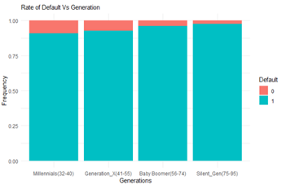
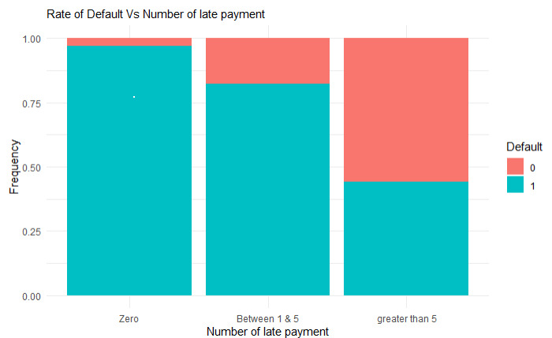
*** Exploratory Data Analysis***
Biz Insights
It is also understood that the rate of default slightly vary according to the age range of the policy holders. The default rate decrease as the age range of the policy holders increases.
The Silent generations (age between 75 & 95) hardly fail in the renewal of their insurance premium while the millennials are the highest defaulters.
Biz Insights
More than 50% of the policyholders that has a record of more than 5 late payment default in the premium payment.
It is also observed that most of the policyholders that do not have any record of late payment hardly miss their payment.
It is also inferred that the rate of default increases as the number of late payment increases.

Slide 5
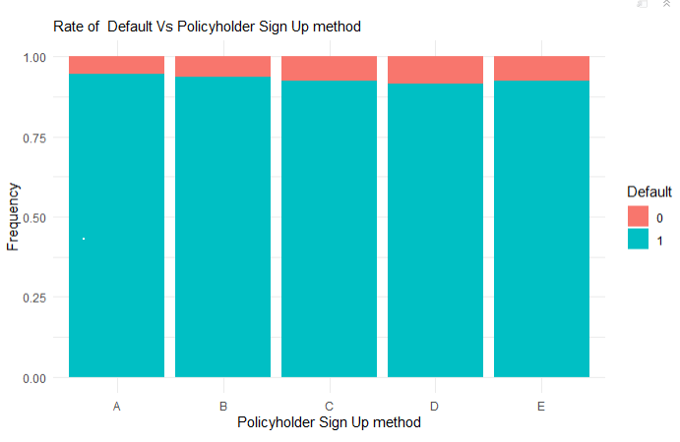
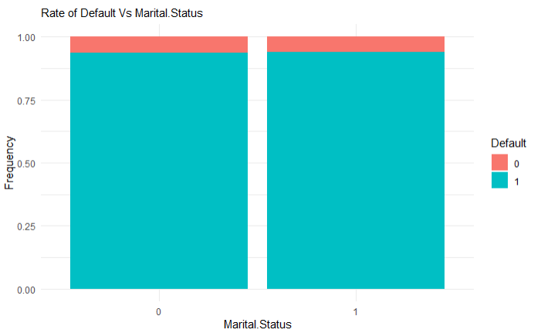
*** Exploratory Data Analysis Conts***
Biz Insights
The rate of default seems to vary accordingly to the method of onboarding the policyholders.
The graph shows that policyholders sourced through channel D defaults in premium payment more than other sources.
The channel A appears to be the least defaulters amongst the rest.
Biz Insights
The renewal of the insurance policy does not seem to be dependent on the marital status of the policyholder. This is noting that the distribution of those that failed to renew the premium payment is same across the marital status.
The test statistic also confirms this as p-value is more than 0.05

Slide 6
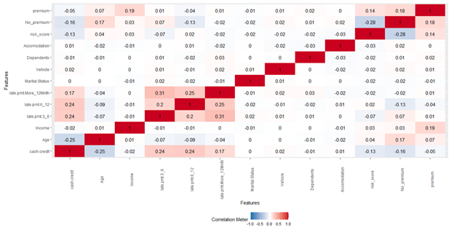
Relationships Amongst Observed Features
Biz Insight:
It appears there is no strong correlation amongst the potential predictor variables as shown the correlation plot above. This means that the predictor variable are independent of each other, thus, the model will not be affected by the problem of multicollinearity.
In other words, the independent variables do not have any effect on another. The increase or decrease in any of the variables do not have any effect on other variables

Slide 7
***Modelling Process validation***
This is basically a process of evaluating and applying different models on training dataset and see which models that performs best for selection. In addition to finding the right model, we are also required to find the right parameters for the model. At the end, the selected model with the appropriate parameter will be evaluated on the testing dataset.
At this stage, let us get the dataset partitioned for model validation and noting the size of the dataset (79,853), there is need for us to take 5% of the whole data to speed-up the model building & iterations. Thereafter, the sample of the dataset is split into two categories in the ratio of 70:30 as explained below:
Training Dataset: 70% of the 10% data-subset. This represent 5,590 dataset
Testing Dataset: 30% of the 10% data-subset. This represent 2,395 dataset.
Model Selection: Since the case under review is classification problem with two class labels, i will be evaluating the following algorithms;
Logistics Regression
Naïve Bayes
Random Forest
KNN and
Xgboost

Slide 8
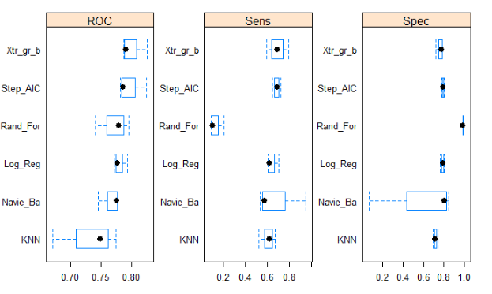
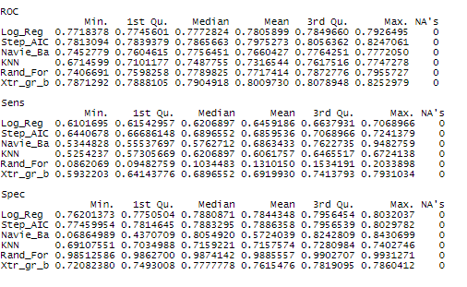
Summary Of The Models Performances:
While the review of other metrics are important for model comparisons, emphasis will be placed on the sensitivity of each models. By sensitivity, we mean the ability of the model to correctly predict policyholder that defaulted in the renewal of the policy. Importance is placed on the sensitivity because it is better for the insurance company to correctly predict customers that will default than those that will not default.
KNN and Naïve Bayes are the worst performing models for the dataset.
Random Forest and Logistic Regression are above average. Their AUC, Sensitivity and Specificity are relatively acceptable when compared with KNN and Random Forest.
Extreme Gradient Boosting performed better than other models under review as its AUC, sensitivity and specificity are higher than others. Thus, Extreme Gradient Boosting is our best model for the dataset.

Slide 9
The Optimization of the Best Model: Extreme Gradient Boosting Model
The Confusion Matrix Before Optimization:
As shown above, the confusion matrix for the model shows that the model misclassified 19 Defaulters out of the 75 Defaulters. While this is improvement from the base model of 6% to 74%, let’s see if the sensitivity can be improved by adjusting the False Negative without compromising the accuracy of the model significantly.
The Confusion Matrix After Optimization:
Adjusting the probability of classification to 0.44, I was able to reduce the misclassification of Defaulters from 25 to 23. This increased the sensitivity of the model from 74% to 83% while the specificity reduced from 76% to an acceptable rate of 73%. The accuracy of the model dropped from 74% to 66% Kindly see the table below.
Prediction Default NotDefault Default 56 280 NotDefault 19 842
Prediction Default NotDefault Default 62 388 NotDefault 13 734

Slide 10
Variable Importance
This measure help to determine predictors that are significant in the model development.
A review of the model’s variables of importance shows that 6 variables contributed 90% predictability power of the algorithm to effectively derive the probability that a policy holder will default in the premium payment or not. The three predictors are as follows:
cash.credit
30%
Late Payment
27%
Source D
14%

Slide 11
Recommendations
Noting the significant weight of source D in the determination probability of default, it is recommended for the company to review this source D in order to reduce the probability of default. While the company should channel its resources to sources with lowest default rate. This could be achieved by designing a product specific to them that will encourage them to be meeting the payment of their premium as at when due.
Given that the rate of the default increases as the number of late payment increases, the company should consider introducing measures that will encourage policyholder to make an early payment. The should consider offering incentive to policyholders that make an early payment.
The company should also review its method of payment as it contributed significantly to the probability of default.

